Slide 1

Sorting Part 2
Dr. Maher Mneimneh

Slide 2
 | Best Runtime | Worst Runtime | Best Memory | Worst Memory
Selection Sort | O(n2) | O(n2) | O(1) | O(1)
Insertion Sort | O(n) | O(n2) | O(1) | O(1)
Bubble Sort | O(n) | O(n2) | O(1) | O(1)
Merge Sort | O(n) | O(nlogn) | O(n) | O(n)
Quick Sort | O(nlogn) | O(n2) | O(logn) | O(n)

Slide 3
Divide-And-Conquer Strategy
Important approach to solving algorithm problems (example sorting)
Strategy:
Break the problem into several sub-problems
Sub-problems similar to original problem but smaller in size
Solve the sub-problems recursively
Combine solutions to create a solution to the original problem

Slide 4
Merge Sort
A recursive sorting algorithm
Gives the same performance, regardless of the initial order of the array items
Strategy
Divide an array into halves
Sort each half
Merge the sorted halves into one sorted array
Is this an improvement over previous algorithms?

Slide 5
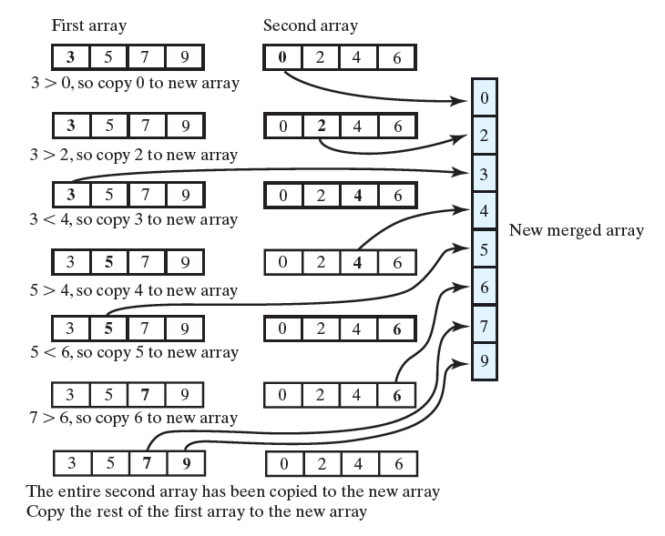
Mergesort : Merging Arrays
Process array from beginning to end
Compare entries and copy smaller entry to new array
After reaching end of one array, copy the remaining entries from other array to new array

Slide 6
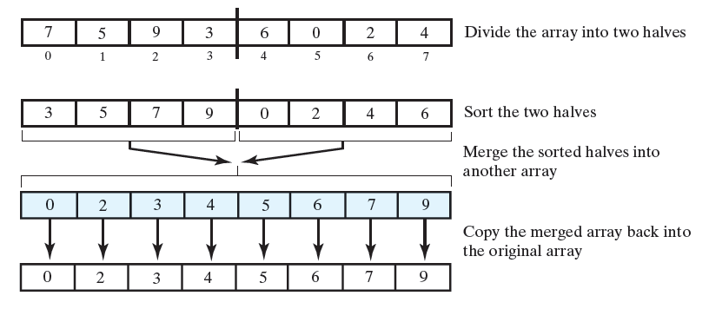
Mergesort : Recursive Mergesort
Divide array in half
Sort 2 halves
How?
Merge sorted halves

Slide 7
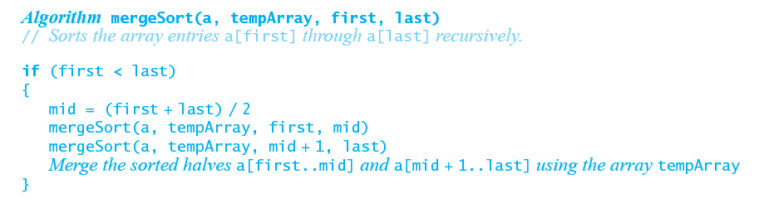
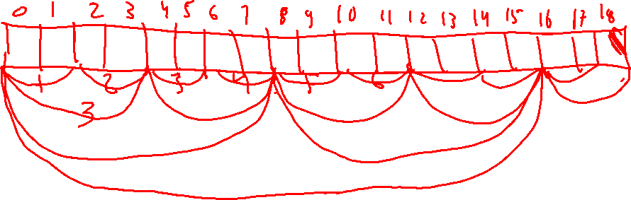
Mergesort : Psuedo Code

Slide 8
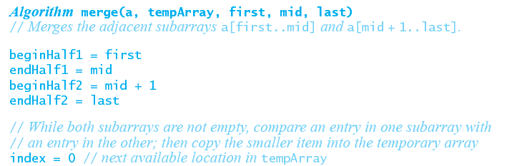
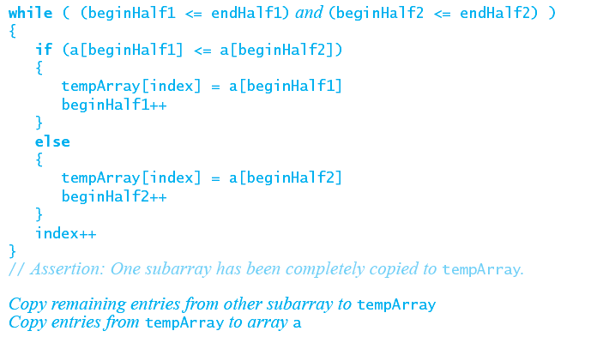
Mergesort

Slide 9
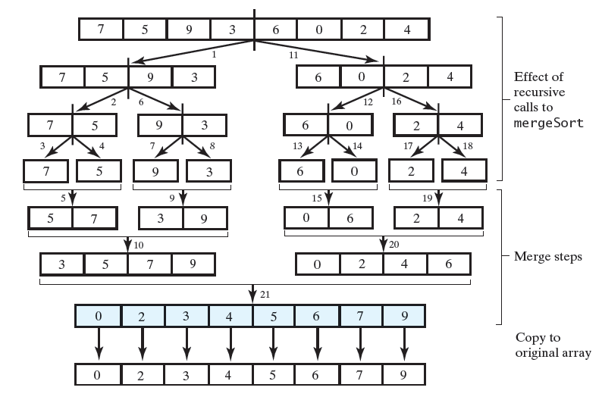

Mergesort : Tracing the steps in the algorithm
Numbers indicate order of recursive calls and the merge
Actual sorting takes place in merge step and NOT in recursive calls

Slide 10
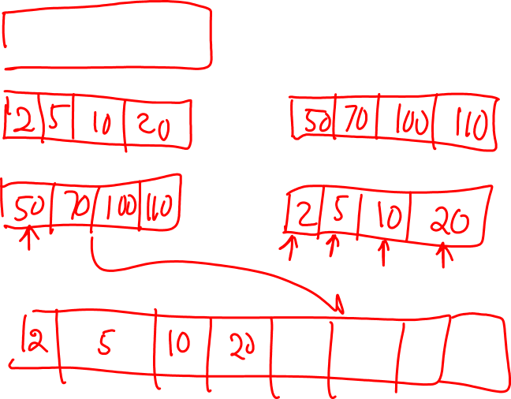
Mergesort: Java Implementation
Implementation

Slide 11
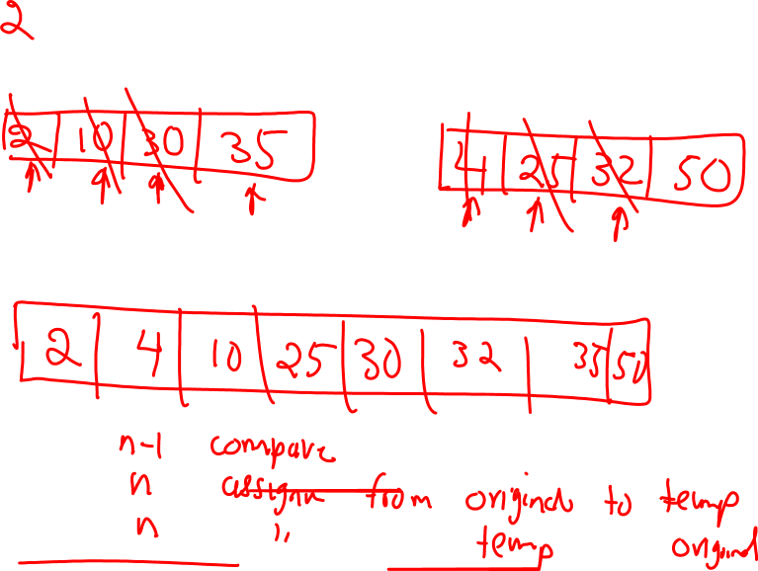

Slide 12
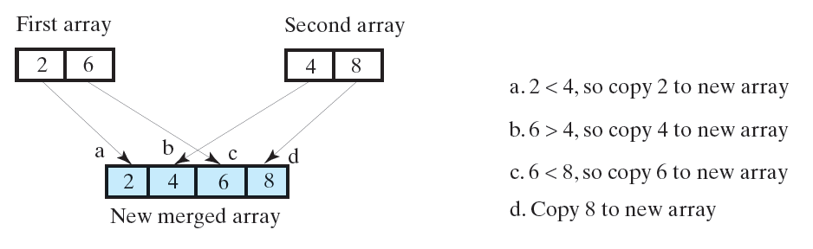

Efficiency of Merge Sort
What is the number of steps required in merging 2 arrays?
Worst case merge:
n-1 comparisons
n moves to temp array
n moves to original array
total: each merge requires at most 3n – 1 comparisons

Slide 13
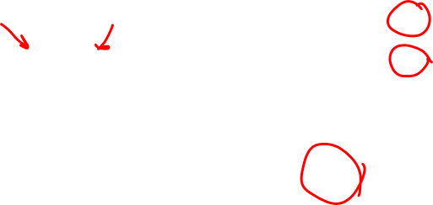
Efficiency of Merge Sort
4(3n/4)=3n
2(3n/2)=3n
3n
At each level we do O(n) operations

Slide 14
Efficiency of Merge Sort
We analyze the efficiency in terms of n: number of elements in array
For n = 2^{k} elements in array
In general k levels of recursive calls are made
E.g: in previous case n =8, so we had 3 levels
Initial call: 2 subarrays of size 4
Second call: 4 subarrays of size 2
Third call: 8 subarrays of size 1
Note: this count is true for any input
We have logn levels and at each level we do O(n) operations, so total cost is O(nlogn)

Slide 15
Efficiency of Merge Sort
Best case analysis:
If array is already sorted how many operations we will perform at each level?
n/2 comparisons for merging n elements
n copying into temp array
n copying into original array
Total = 5n/2 which is O(n)
Best case is lognO(n) = O(nlogn)
Memory usage of mergeSort:
Temporary array equal size of original array is needed: O(n)
Stack memory for recursion: O(logn)
Total memory: O(n)+O(logn) = O(n)
Remember memory/time trade-off
Exercise:
Modify MergeSort algorithm so that if none of entries on right is greater than entries on left, no merging takes place
Does this changes the big O complexity of the algorithm? O(n) time for best case

Slide 16
Efficiency of Merge Sort : Recurrence Relations*
Let t(n) be the running time on input of size n
Based on algorithm, we can write runtime as t(n)= 2t(n/2) +O(n)
How to solve: t(n) = 2t(n/2) + n for n > 1, t(1) = 0?
t(8) = 2t(4) + 8
t(4) = 2t(2) + 4
t(2) = 2t(1) + 2 =2
t(4) = 2(2) + 4 = 4x2
t(8) = 2(8) + 8 = 8x3
We can conclude t(n) = nlogn
High level observation:
Solve problem of size n by:
Solving the same problem twice on size n/2
Merge the result in O(n) time
Resulting algorithm: O(nlogn)

Slide 17
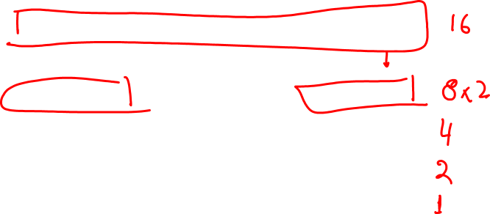
General Recurrences
t(n) = 2t(n/2) + O(n) → O(nlogn) [e.g, worstcase runtime for merge sort)
t(n) = 2t(n/2) + O(1) → O(n) [e.g, bestcase for merge sort, finding minimum using recursion]
t(n) = 3t(n/3) + O(n) → O(nlogn) [if we divide into 3 subarrays, runtime will not improve)

Slide 18
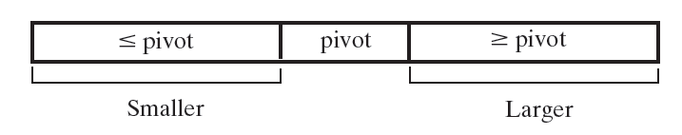
Quick Sort
Like merge sort, divides arrays into two portions
Unlike merge sort, portions not necessarily halves of the array
One entry called the “pivot”
Pivot in position that it will occupy in final sorted array
Entries in positions before pivot less than or equal to the pivot
Entries in positions after pivot are greater than or equal to the pivot
If pivot is always in middle, the algorithm reduces to mergeSort
Why are we trying to change pivot location?
See if we can get a better algorithm

Slide 19
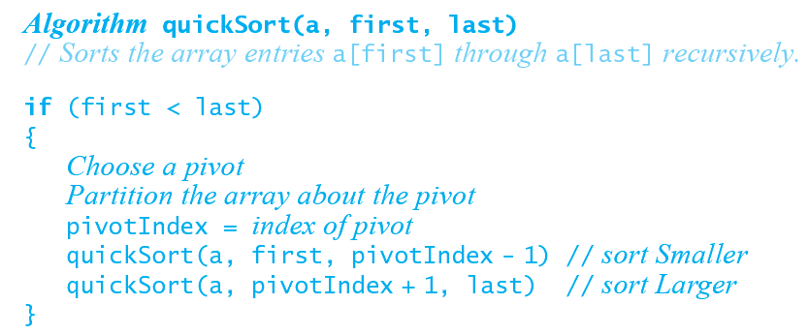
Quick Sort: Algorithm

Slide 20
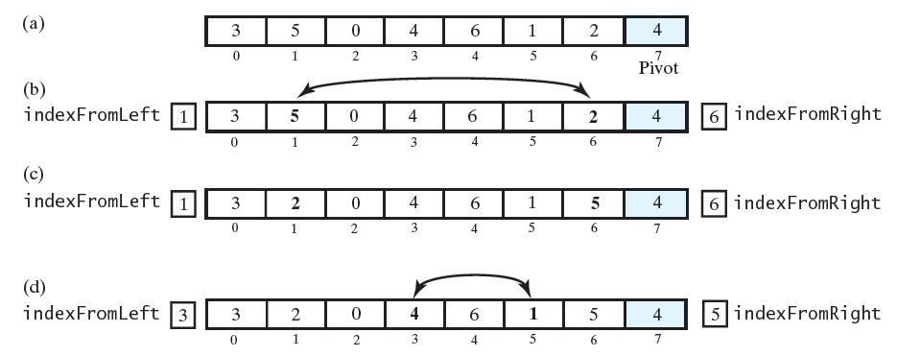
Quick Sort: Partition
Choose last element as Pivot
Moving from left to right, find first element >= Pivot (5, indexFromLeft=1)
Moving from right to left, find first element <= Pivot (2, indexFromRight=6)
If indexFromLeft < indexFromRight, swap entries at those indices
2 has moved to beginning of array, 5 has moved toward end of array
Repeat

Slide 21
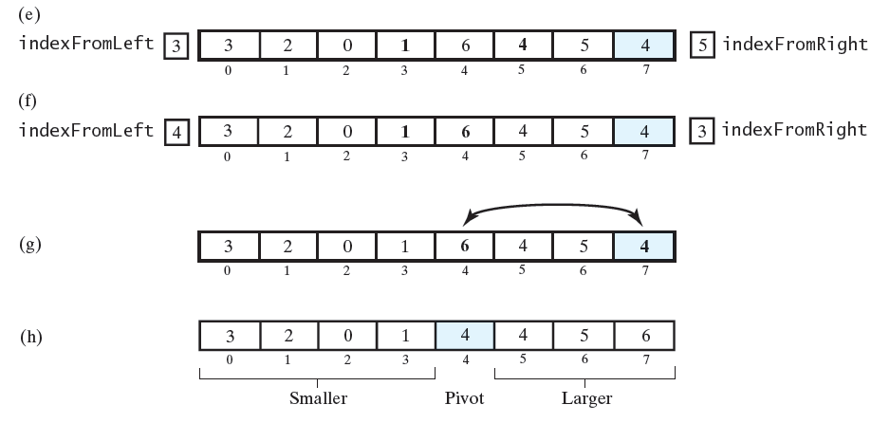
Quick Sort: Partition
Choose last element as Pivot
If another element is chosen simply swap it with the last element
Moving from left to right, find next element >= Pivot (6, indexFromLeft=4)
Moving from right to left, find first element <= Pivot (1, indexFromRight=3)
indexFromLeft >= indexFromRight, so stop
last step: swap end with indexFromLeft

Slide 22
A Good Case for Quick Sort
10
11
3
4
15
2
5
2
11
3
4
15
10
5
2
11
3
4
15
10
5
2
4
3
11
15
10
5
2
4
3
11
15
10
5
2
4
3
5
15
10
11
2
4
3
5
15
10
11
2
4
3
5
15
10
11
2
3
4
5
15
10
11
2
4
3
5
10
15
11
2
4
3
5
10
11
15
2
3
4
5
15
10
11
2
3
4
5
15
10
11
2
3
4
5
10
11
15
2
3
4
5
10
11
15

Slide 23
Worst Case – Quick Sort
sorted array
1
5
8
10
12
13
21
1
5
8
10
12
13
1
5
8
10
12
1
5
8
10
1
5
8
1
5
1

Slide 24
Efficiency of Quick Sort
When does the worst case for quick sort occurs?
If pivot is largest or smallest element
Results in n levels of recursive calls (instead of logn)
This results in O(n²)
If every choice of pivot causes equal sized arrays, recursive calls halve the array
Results in O(n log n)
Identical to MergeSort
What is the space requirements:
Each recursive call allocates space on the stack
In worst case we have n recursive calls so O(n)
Can be reduced to O(logn) by some tricks

Slide 25
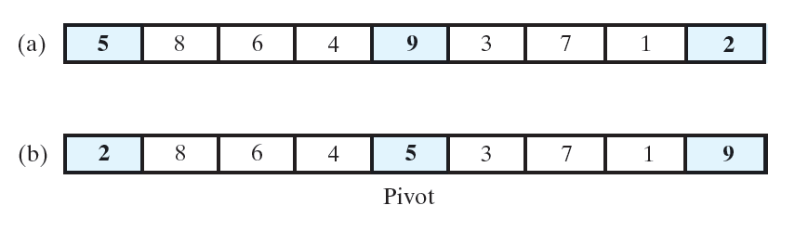
Quick Sort: Pivot Selection
Ideal strategy: choose best pivot
Choose the median of the array to be the pivot
This strategy results in O(nlogn) (similar to mergeSort)
But finding median requires sorting array and getting middle element!
Circular logic!
Strategy 2: Avoid a bad pivot
Take the median of three entries: first, middle and last in array
To accomplish this: sort 3 elements and take the middle
Strategy called median-of-three pivot selection
Strategy avoid worst case when array is already or nearly sorted

Slide 26
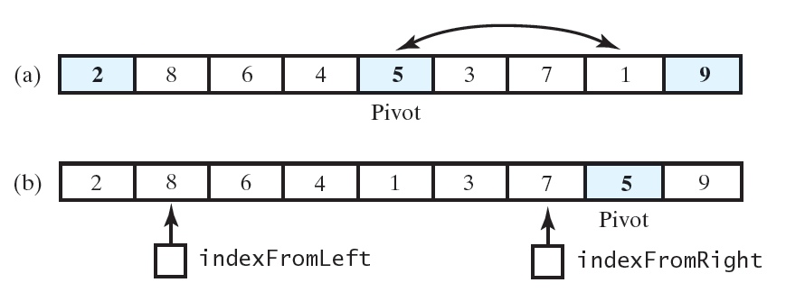
Quick Sort: Modified Partition Algorithm
Before Pivot was swapped with the last entry
first, middle and last are sorted
First and last already satisfy the requirement of the partition
Can leave those entries in their location
Pivot should be swapped with next-to-last entry
We can begin the search from left at first+1
We can begin the search from right last - 2

Slide 27
Quick Sort: Java Implementation
Implementation

Slide 28
Quick Sort
Analysis
usually extremely fast in practice
Average case complexity is O(nlogn)
Even if the worst case occurs, performance is acceptable for moderately large arrays

Slide 29
Stable Sorts
A sort is stable if it doesn’t change the order of equal objects
E.g: 3 2_{a} 4 2_{b}
Output of a stable sort: 2_{a} 2_{b} 3 4 (order of 2s preserved)
Possible output from a non-stable sort: 2_{b} 2_{a} 3 4
When is stability important?
Assume we have group of employees and we sort employees first by IDs and then by age:
(id, age) : (1, 25), (3, 28), (2, 28)
First sort by id:
(1,25), (2,28), (3,28)
Second sort by age:
Stable sort: (1,25), (2,28), (3,28) (employees of same age are still sorted by ID)
Unstable sort: (1,25),(3,28), (2,28) (employees of same age are NOT sorted by ID)
Property is important in practice

Slide 30
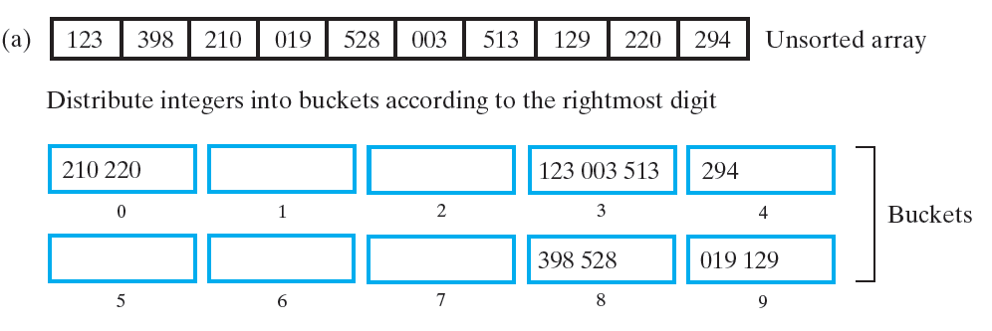
Radix Sort
Previously seen sorts on objects that can be compared
use compareTo()
Radix sort does not use comparison
Looks for matches in certain categories
Places items in “buckets”
Strategy:
Begin by grouping integers by right-most digits
We have 10 buckets
Maintain the order of the elements in the buckets
Example: 19 and 3 padded with 0s

Slide 31
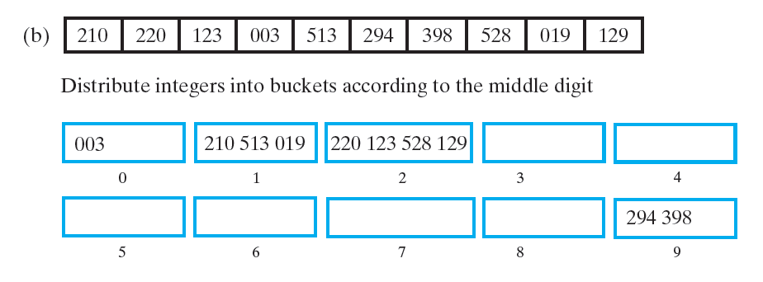
Radix Sort
After first round, elements are in the order shown below
Next, group the integers by the middle digit

Slide 32
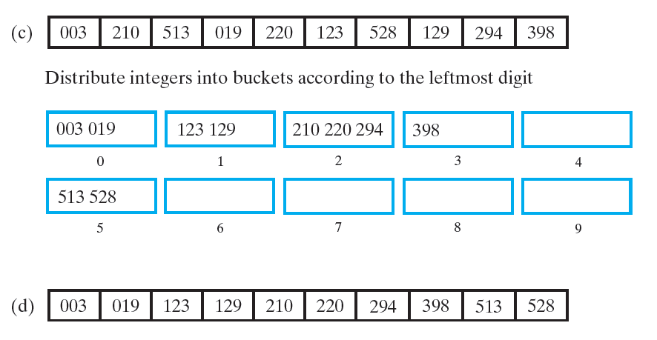
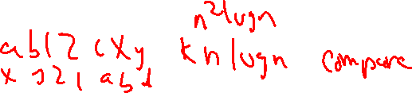
Radix Sort
After second round, elements are in the order shown below
Next, group the integers by the left digit

Slide 33

Radix Sort: Intuition on Why it Works
We start by sorting first digit from right
If other digits are deleted, the numbers are sorted in the right order
E.g: 24 12 22 31
Sort: 31 12 22 24
Two possible scenarios after we sort by second digit from right
Numbers having different second digits (e.g. 22 and 31)
These will be correctly ordered (e.g: 22 < 31)
Operation in first step not important
Numbers having the same second digit (e.g 22 and 24)
These will be correctly ordered based on result of first step
Thus, requires the sorting to be stable

Slide 34
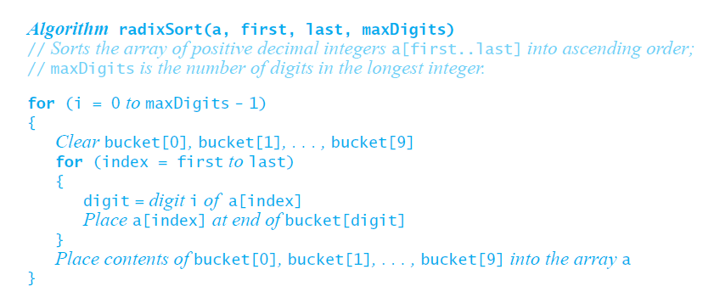
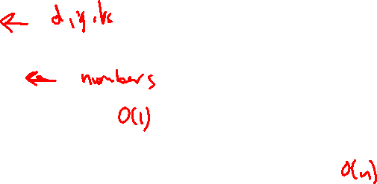
Radix Sort : Pseudo code
Number digits from the right beginning at 0
maxDigits is number of digits in largest integer
Return a 0 for a digit that doesn’t exist (eg: 0th digit of 2 is 2, 1st digit is 0)

Slide 35
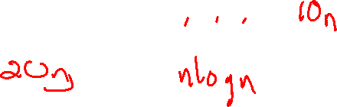
Radix Sort: Analysis
Inner loop iterates n times
If each integer contains d digits, outer loop iterates d times
O(dn)
What are practical values for d?
On 32-bit machines ~ 10 decimal digits (largest integer: 4294967295)
On 64-bit machines ~ 20 decimal digits (largest integer: 18446744073709551615)
As long as n is much larger than d, algorithm is O(n)

Slide 36
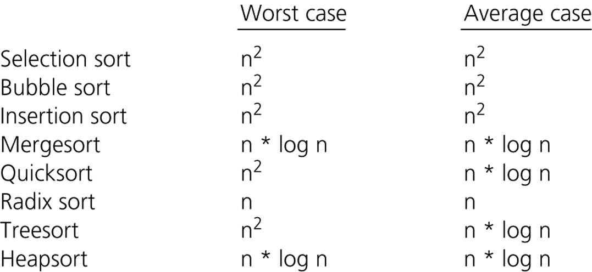
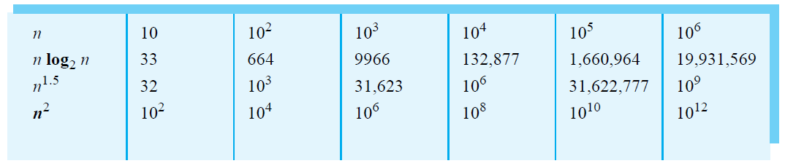
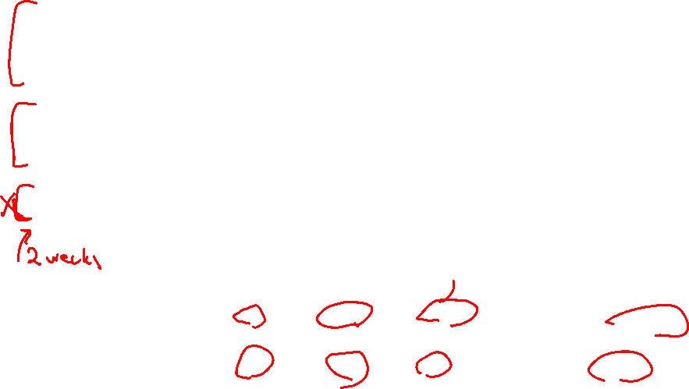
A Comparison of Sorting Algorithms

